Slide 1
Processing, Sample Std_{TODO}, & Batch Correction_{TODO} _{pass1a data original}
Alec Steep

Slide 2
PASS1A Metabolomics Datasets (n = 205)
Tissues
(n = 20)
Targeted (Y/N)
Sites
(n = 6)
Technology
Platform
Named (Y/N)
# of Samples
# Metabolites
Metabolomics release 2.0, received October 15th, 2020 from MoTrPAC DataHub (motrpac-data.org)
Notes:
This is PASS1A metabolomics release 2.0 and it has 205 datasets, It’s different than RNASEq, it’s much more complex.
There’s 6 sites here, if we had RNASEq from 6 sites, then we wouldn’t have 205 datasets.
-The Datasets are split up by all sorts of variables, different platforms, different sites, different technologies, named or unnamed
-You can think of this as a 6 Dimension annotation
-At the bottom here, you can actually see a distribution if # of metabolites and # of samples, so you can really get a sense as to where these samples and metabolites consentrate.
-Today, we are going to look at comparions between these datsets.
-We’re gonna focus on comparisons with the largest overlap between samples and features as an example to highlight some of the major conclusions we see in other comparisons.
-Today we’re concerned with named dataset, so one of the first things we’re gonna to is removed the unnamed dataset.

Slide 3
Processing Decisions/Statistics
rppos
rpneg
ionpneg
Notes:
-Rppos, rpneg, and ionpneg
-9 tissues in each technology
Explain columns
-comparable number of test samples
-some samples contain less reference samples
-most features in rppos
-least features in ionpneg
-no negative or zero values
-liver and wadi seem to contain the most missing features
-badi and wadi contain the most outlier samples that I’m confident about (investigate gas)
-The presence of internal standards is somewhat haphazard, they serve only a QC purpose and they should be removed
-The variable P does not reflect the internal standard number

Slide 4
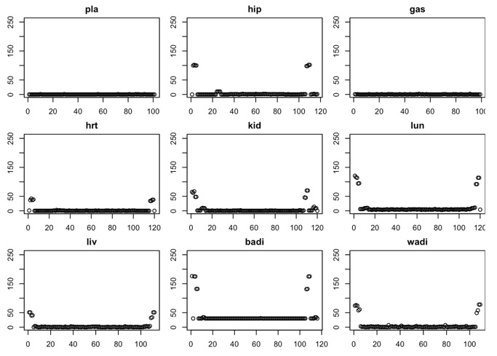
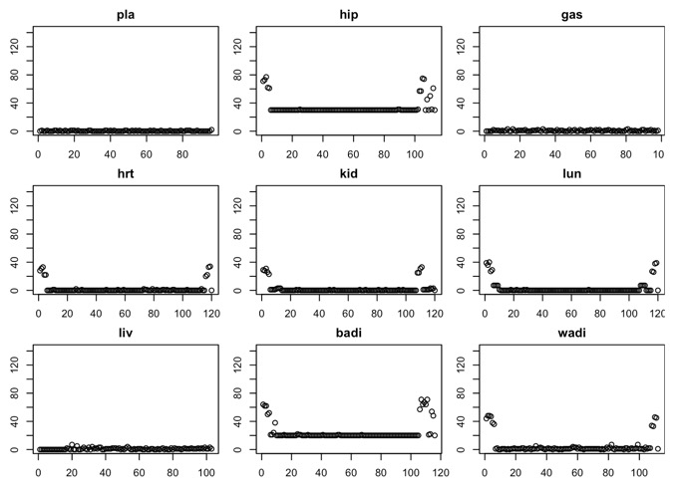
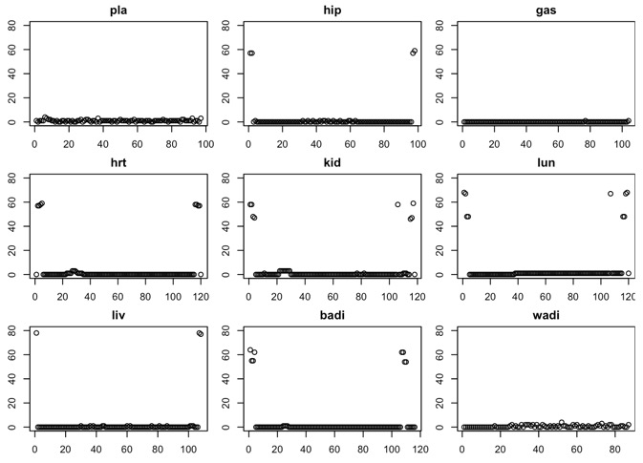
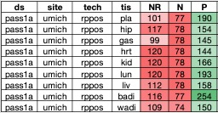
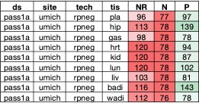
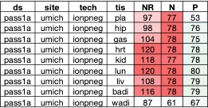
rppos
rpneg
ionpneg
Number of Missing Values
Samples
Samples
Samples

Slide 5
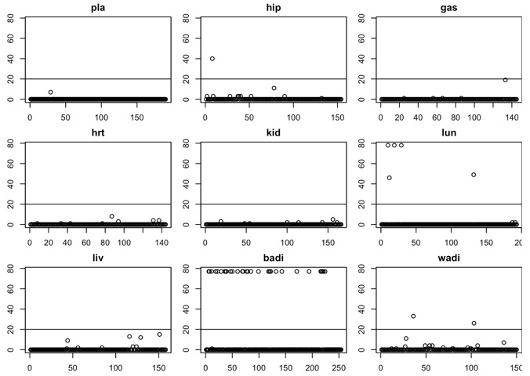
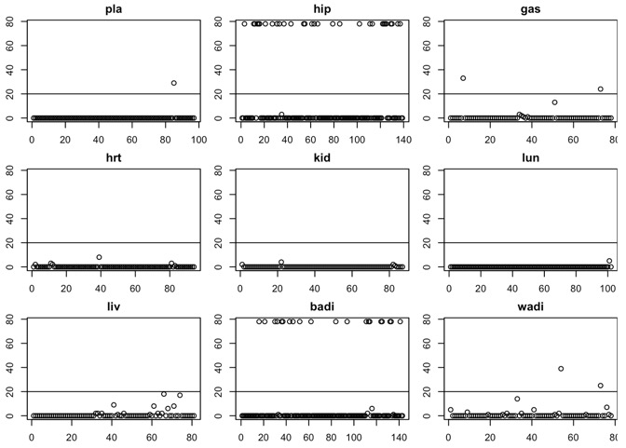
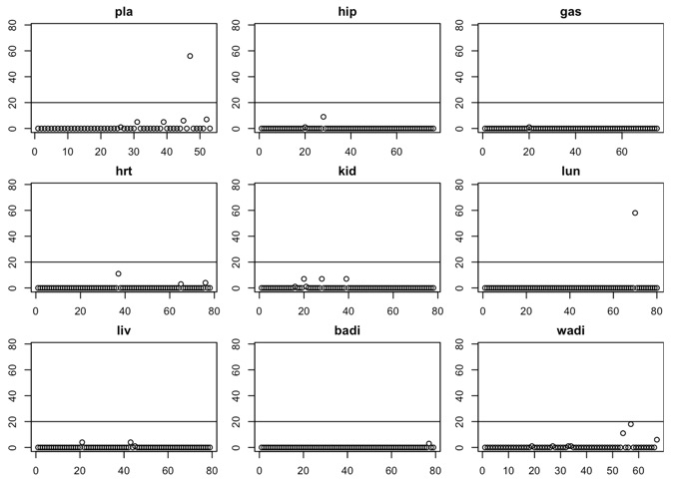
rppos
rpneg
ionpneg
Number of Missing Values
Features
Features
Features

Slide 6
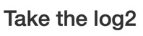
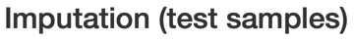
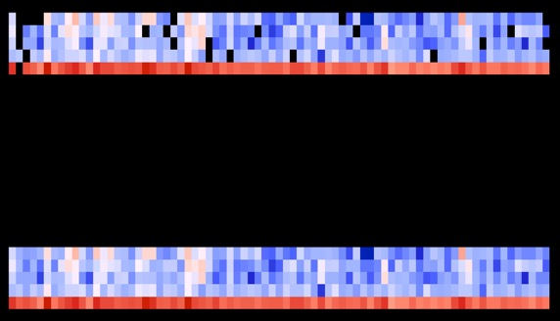
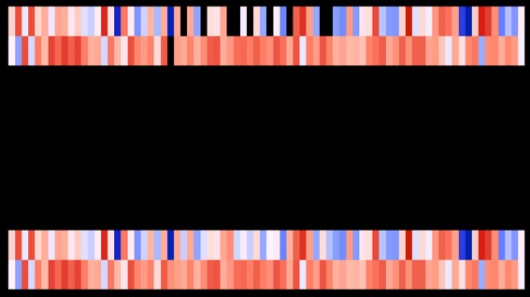
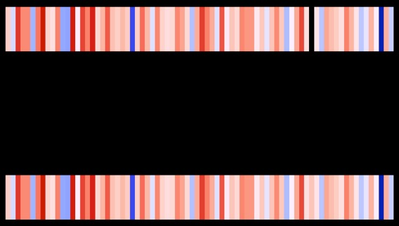
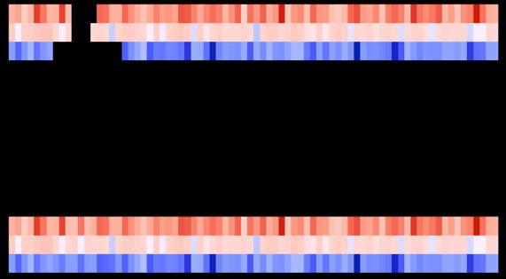
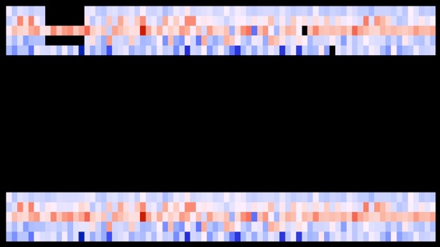
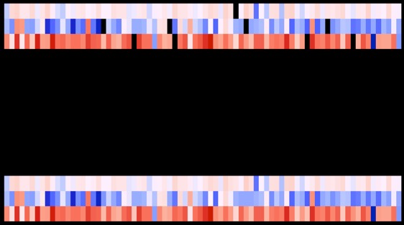
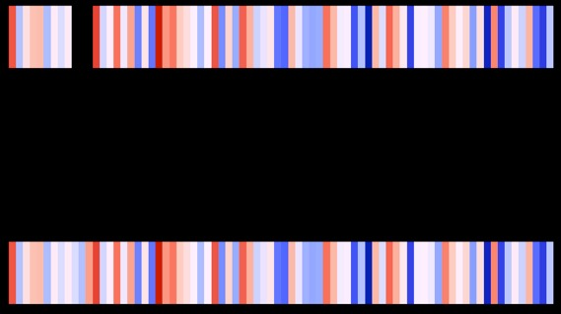
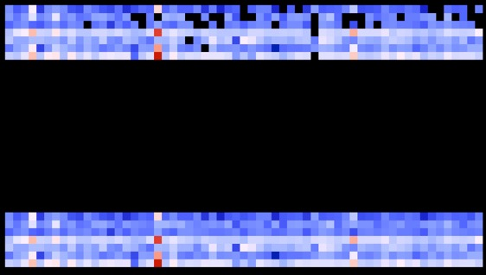
ionpneg
pla
hip
gas
hrt
kid
lun
No Missing Values
liv
badi
wadi

Slide 7
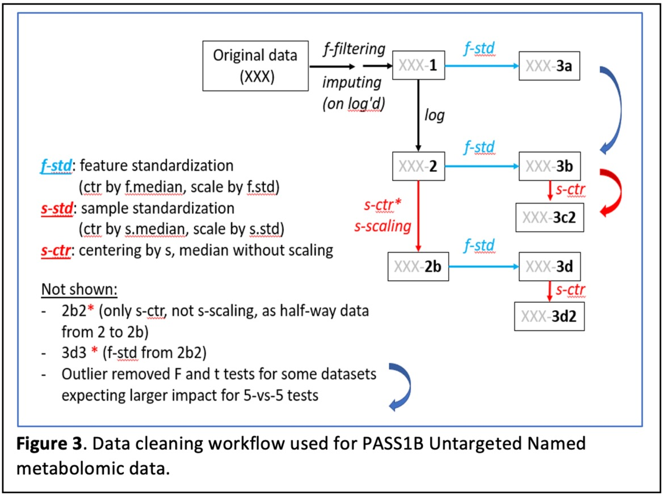
Transformation Workflow

Slide 8
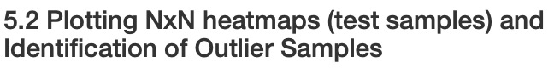
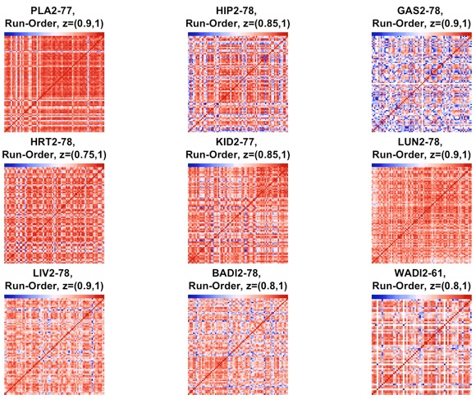
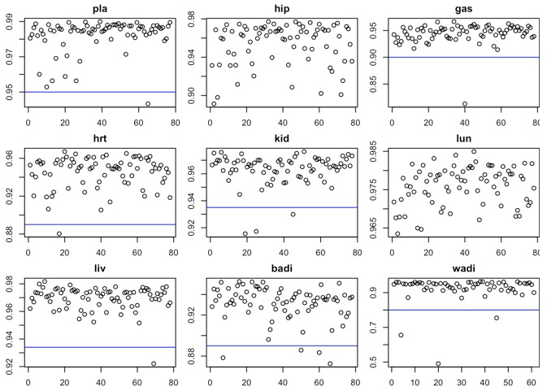
ionpneg

Slide 9
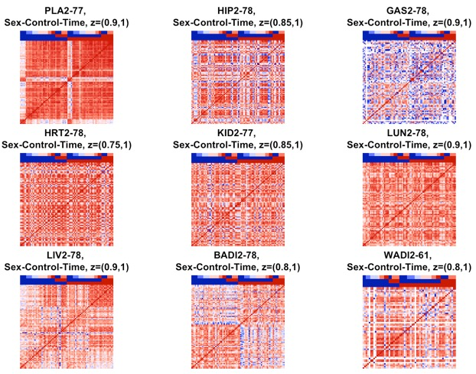
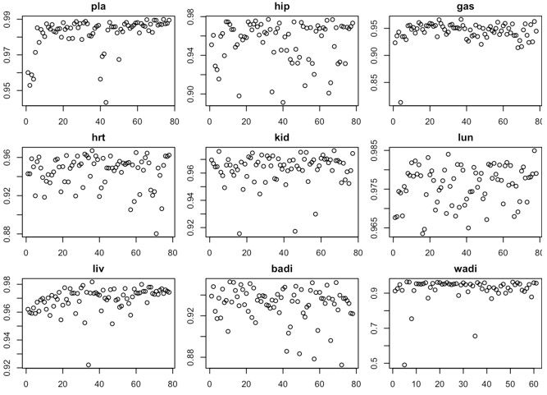
ionpneg

Slide 10
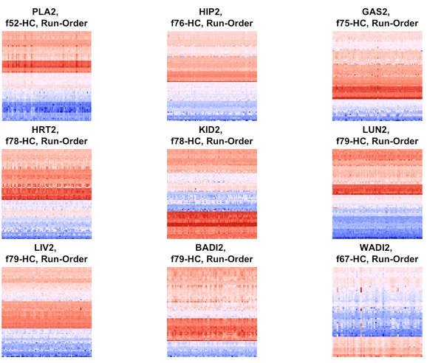
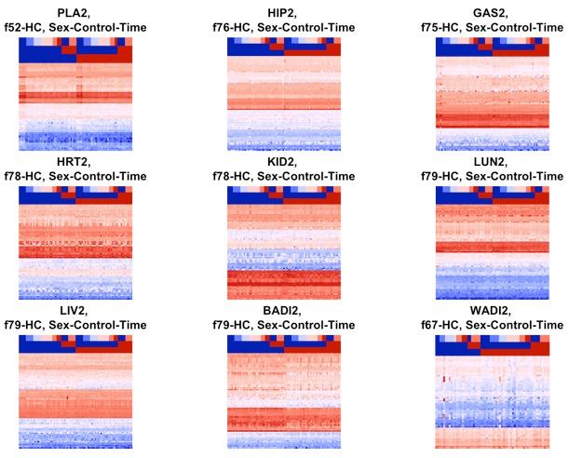
ionpneg

Slide 11
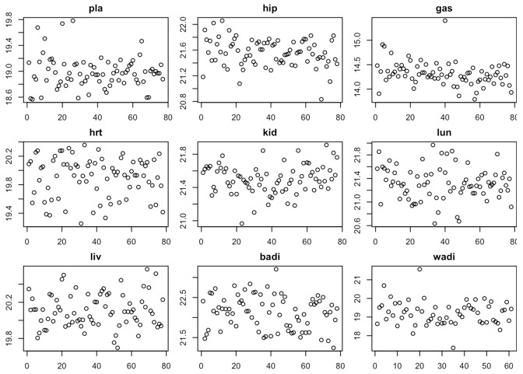
ionpneg

Slide 12
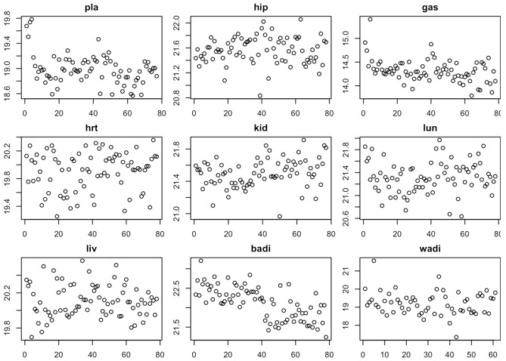
ionpneg

Slide 13
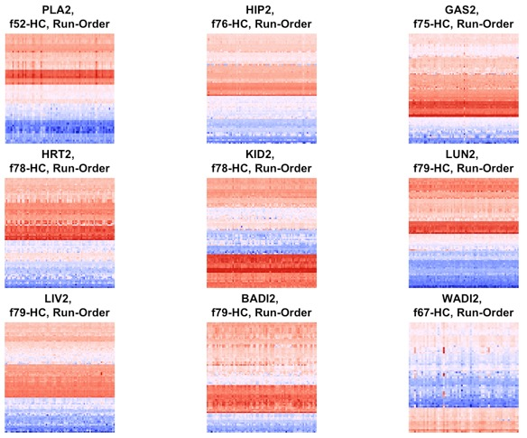
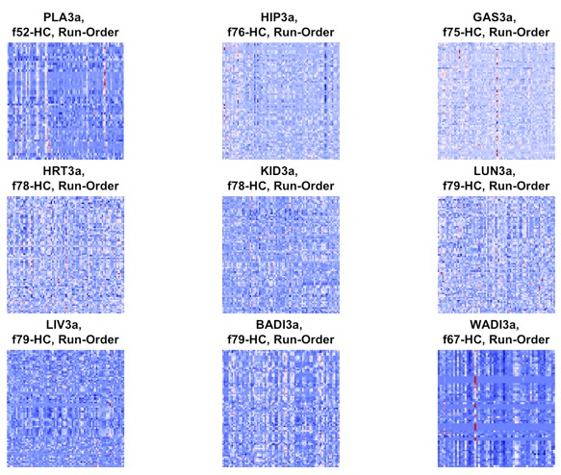
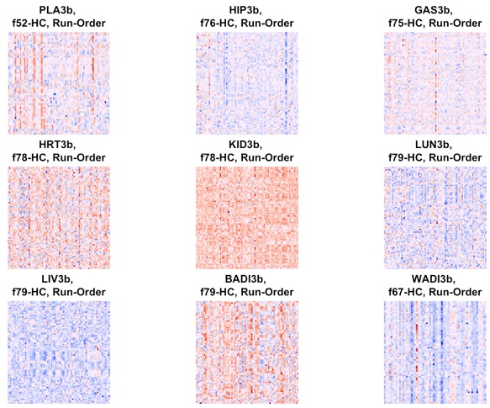
ionpneg
Log2 +

Slide 14
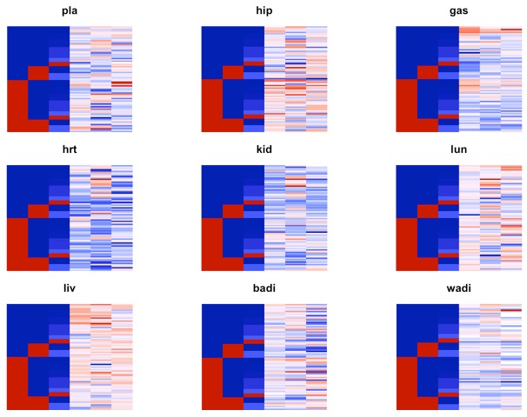
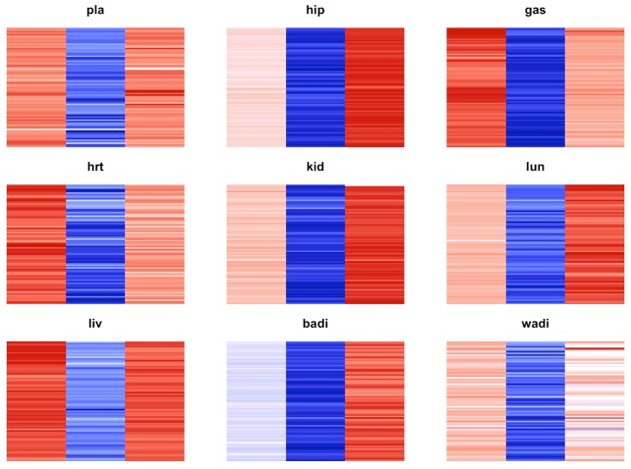
Sample Medians umich rppos, rpneg, ionpneg
sex
contrl
time
rppos
rpneg
ionpneg
Processed (Log2; Col-Centered)
Processed (Log2)
rppos
rpneg
ionpneg

Slide 15
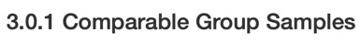
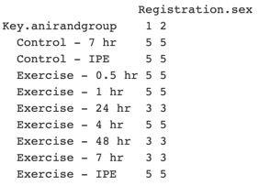
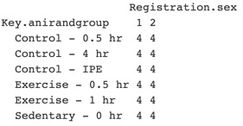
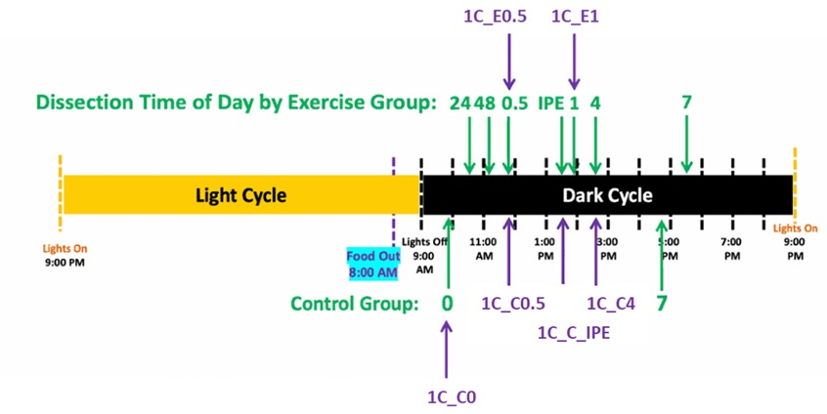
Figure generated by Jun Li, PhD

Slide 16
y_{j,i} = abundance of metabolite j in tissue I
y_{j,i} = a + B₁(batch) + B₂(run_order) + B₃(experimental_group) + E

